Slide 1
Middle School PFA Presentation Greg Wasserman Director of Guidance

Slide 2
Technology Census

Slide 3
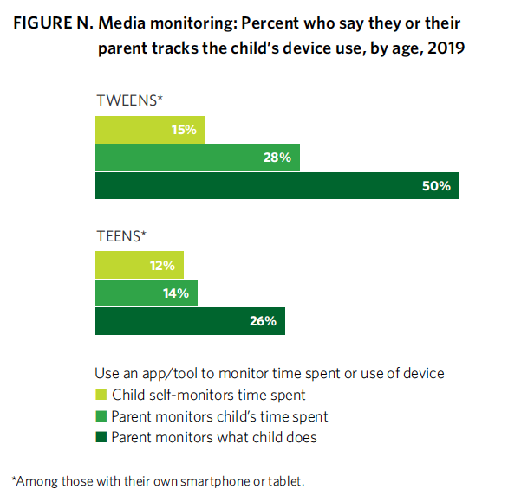

Slide 4
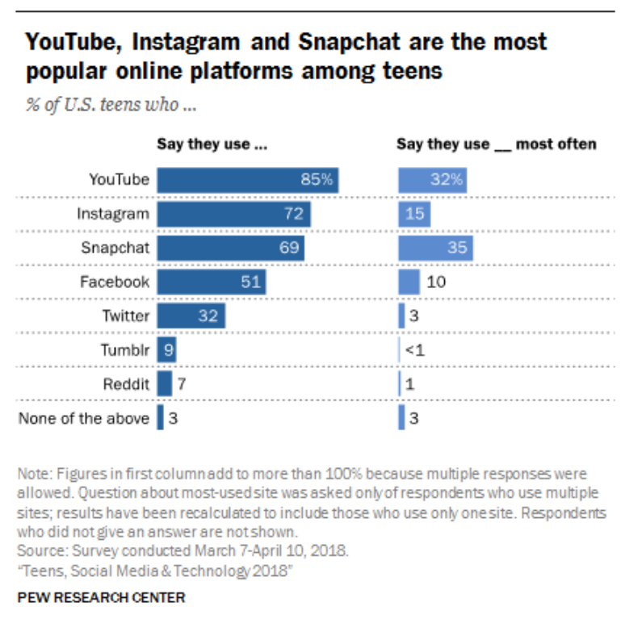

Slide 5
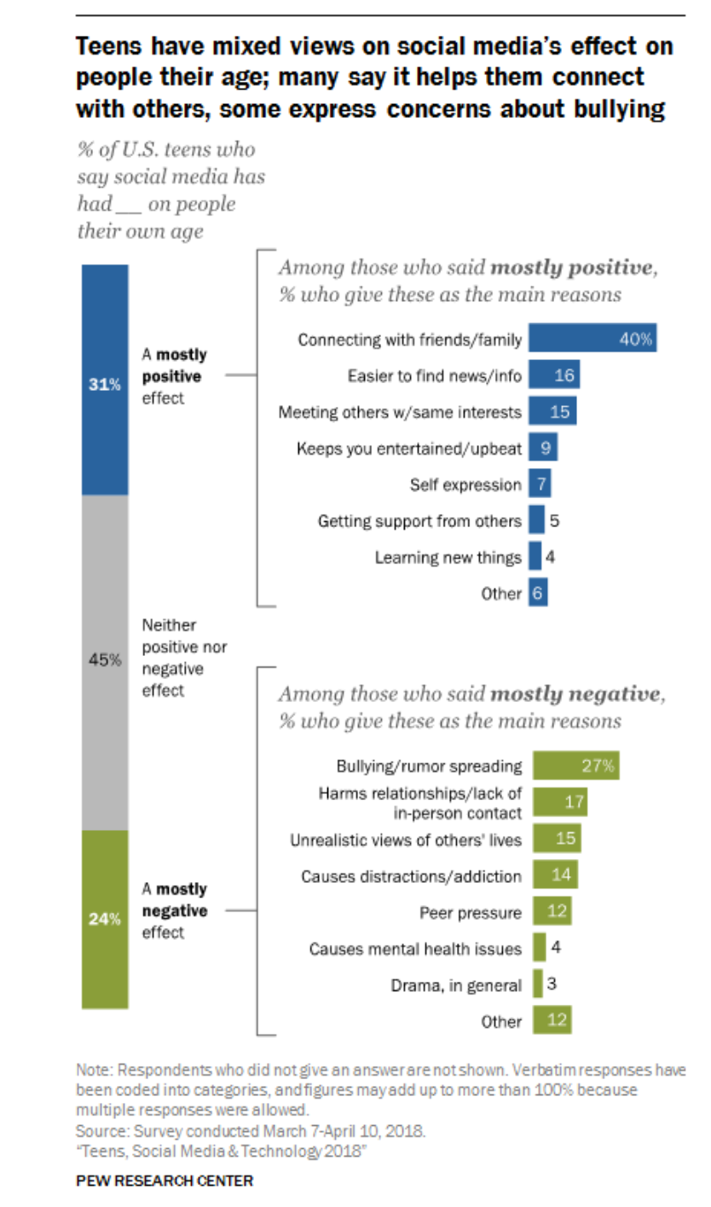

Slide 6
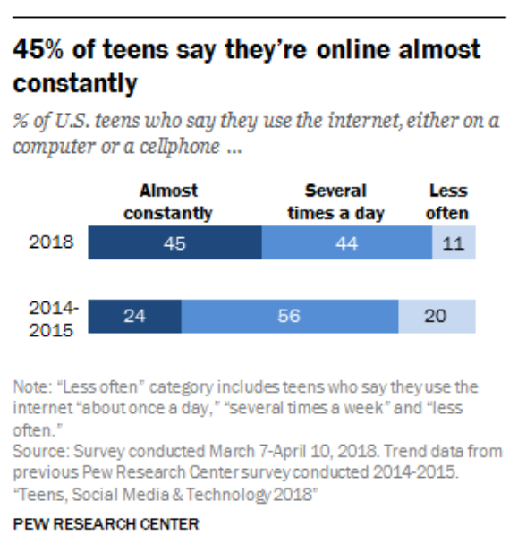

Slide 7
https://www.commonsensemedia.org/video/modal/5457846?height=420&iframe=1&width=660
https://youtu.be/PSK3pabBjHU
https://www.commonsensemedia.org/video/modal/6062160?height=420&iframe=1&width=660

